Slide 1
Bayesian Inference
Module 4, Lesson 1

Slide 2
Normal Approximation
Shahrzad Jamshidi, PhD

Slide 3
Last Time
Logistic Regression
The Bioassay example
The basic process of modelling

Slide 4
Objectives
Understand and apply normal approximations to posterior distributions in Bayesian inference.
Recognize the conditions under which normal approximations are valid.

Slide 5
Topics to Review for This Lesson
Mode
Taylor series in higher dimensions
Normal distribution in higher dimensions
Jacobian

Slide 6
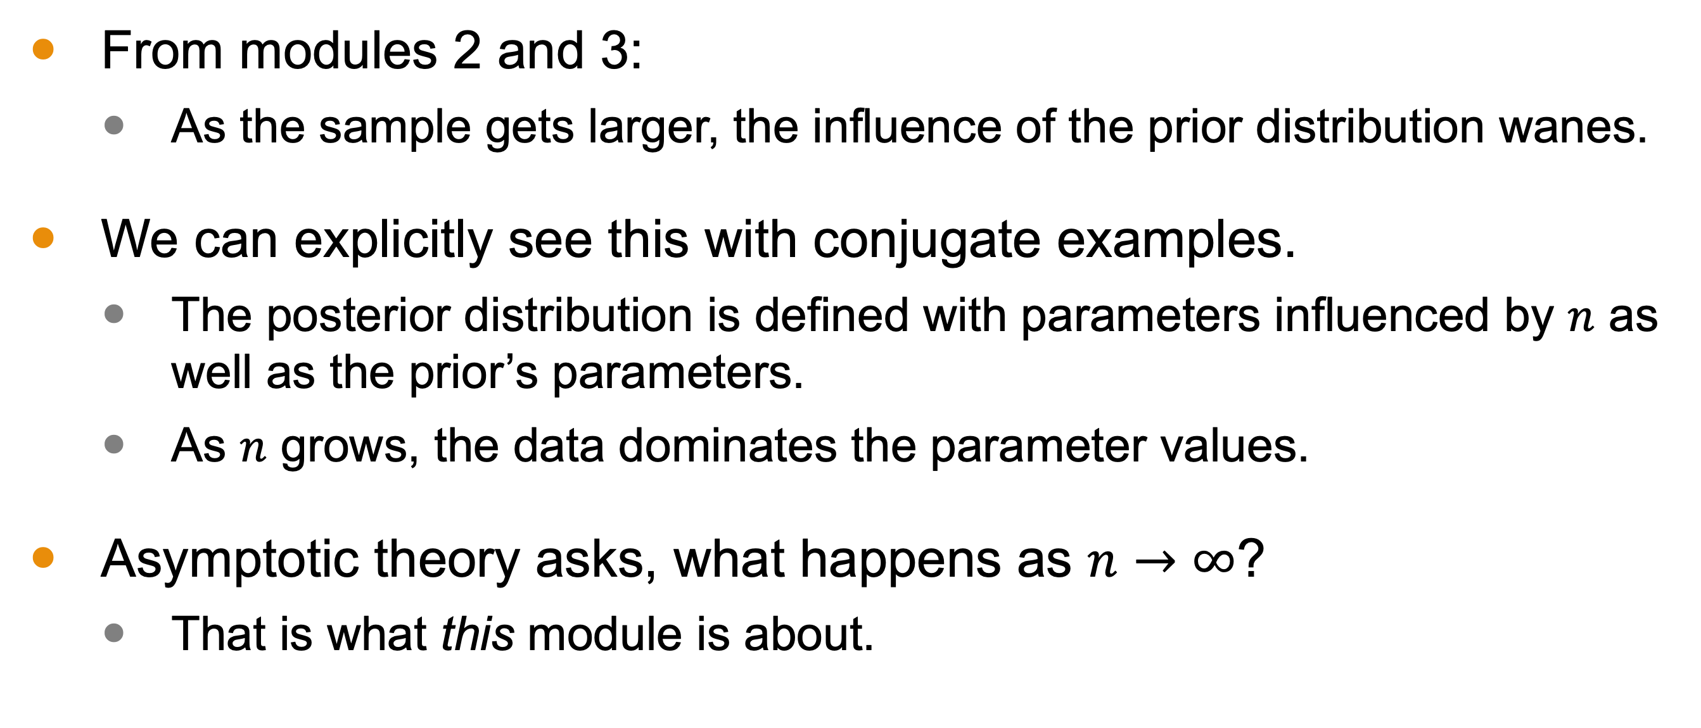
Review from this Class
From modules 2 and 3:
As the sample gets larger, the influence of the prior distribution wanes.
We can explicitly see this with conjugate examples.
The posterior distribution is defined with parameters influenced by $n$ as well as the prior’s parameters.
As $n$ grows, the data dominates the parameter values.
Asymptotic theory asks, what happens as $n→∞$?
That is what this module is about.

Slide 7
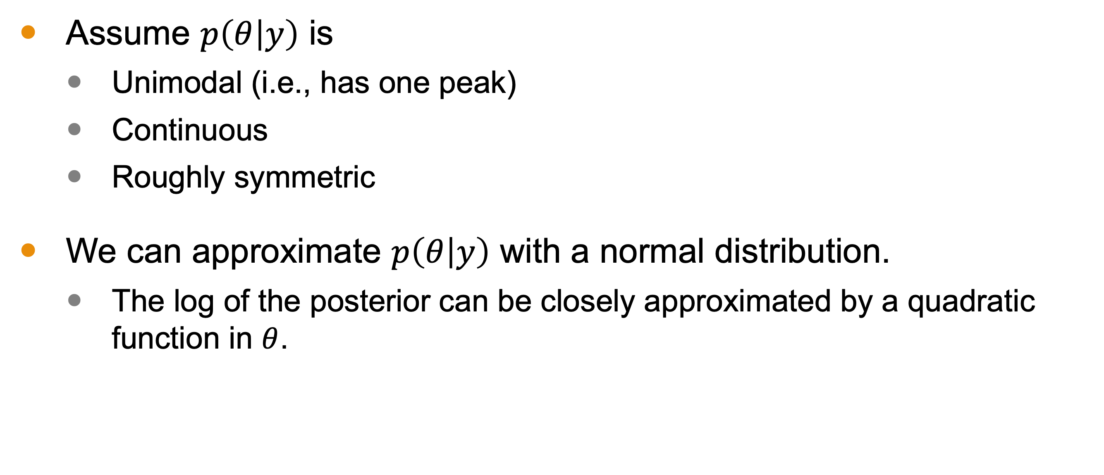
Approximating the Joint Posterior Distribution
Assume $p\left(θ | y\right)$ is
Unimodal (i.e., has one peak)
Continuous
Roughly symmetric
We can approximate $p\left(θ | y\right)$ with a normal distribution.
The log of the posterior can be closely approximated by a quadratic function in $θ$.
Has a local max

Slide 8
Constructing the Normal Approximation
Identify the peak
Construct the Taylor series up to degree 2
Define the elements of the normal distribution

Slide 9
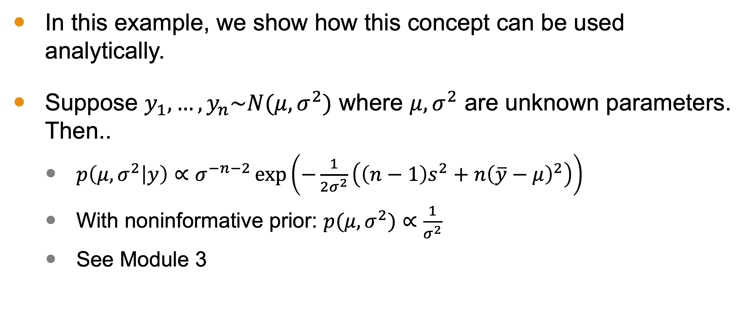
Example: Normal with unknown parameters
In this example, we show how this concept can be used analytically.
Suppose $y_{1},…,y_{n}\sim N(μ,σ^{2})$ where $μ,σ^{2}$ are unknown parameters. Then..
$p\left(μ,σ^{2} | y\right)∝σ^{−n−2}\exp\left(−\frac{1}{2σ^{2}}\left(\left(n−1\right)s^{2}+n{\left(\overline{y}−μ\right)}^{2}\right)\right)$
With noninformative prior: $p(μ,σ^{2})∝\frac{1}{σ^{2}}$
See Module 3

Slide 10
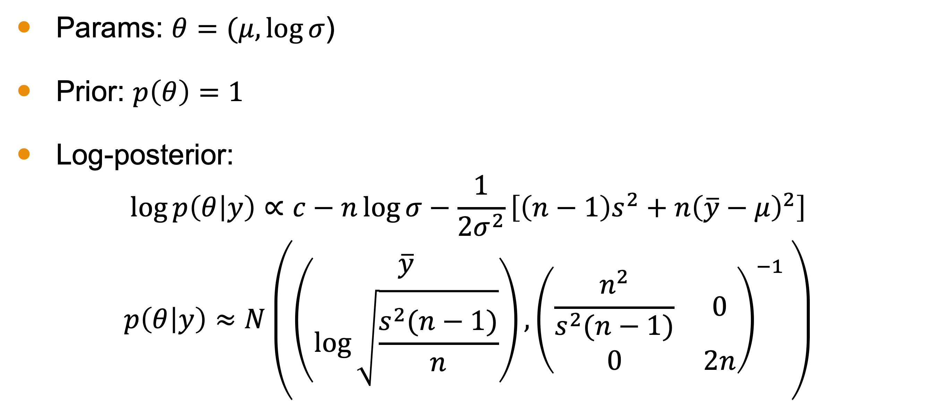
Summary
Params: $θ=(μ,\log{σ}$)
Prior: $p\left(θ\right)=1$
Log-posterior:
$$\log{p\left(θ | y\right)}∝c−n\log{σ}−\frac{1}{2σ^{2}}\left[\left(n−1\right)s^{2}+n{\left(\overline{y}−μ\right)}^{2}\right]$$
$$p\left(θ | y\right)≈N\left(\left(\begin{matrix}\overline{y} \\ \log{\sqrt{\frac{s^{2}(n−1)}{n}}}\end{matrix}\right),{\left(\begin{matrix}\frac{n^{2}}{s^{2}(n−1)} & 0 \\ 0 & 2n\end{matrix}\right)}^{−1} \right)$$

Slide 11
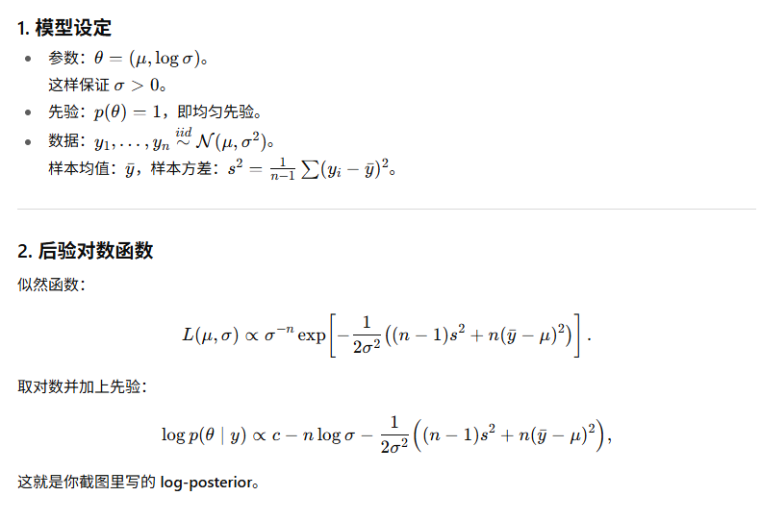
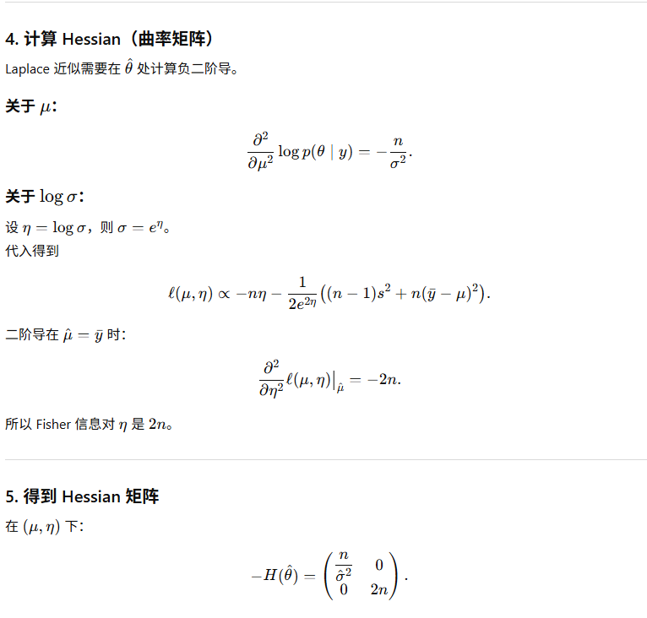
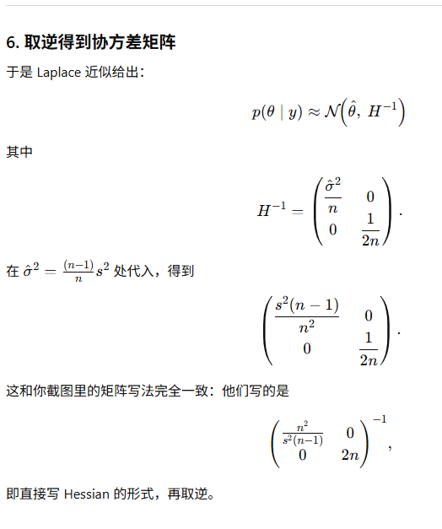
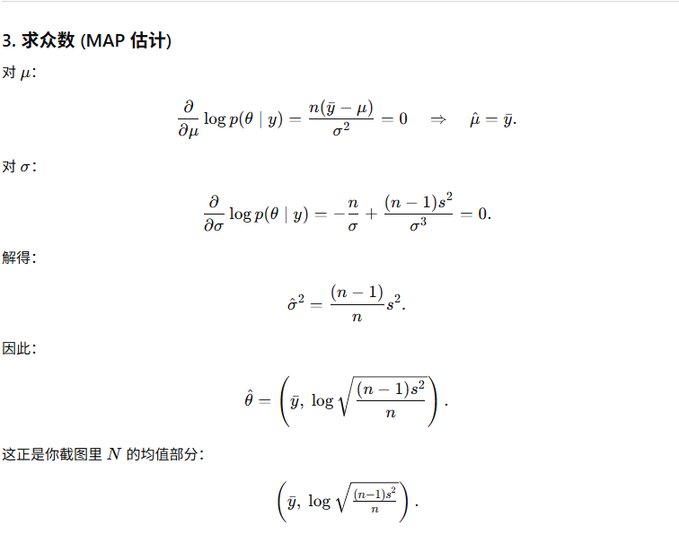
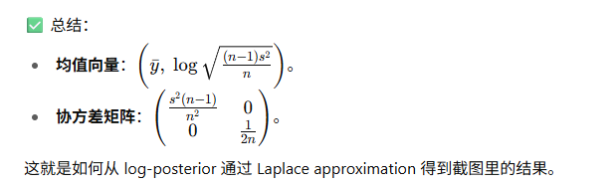
Notes:
Compute

Slide 12
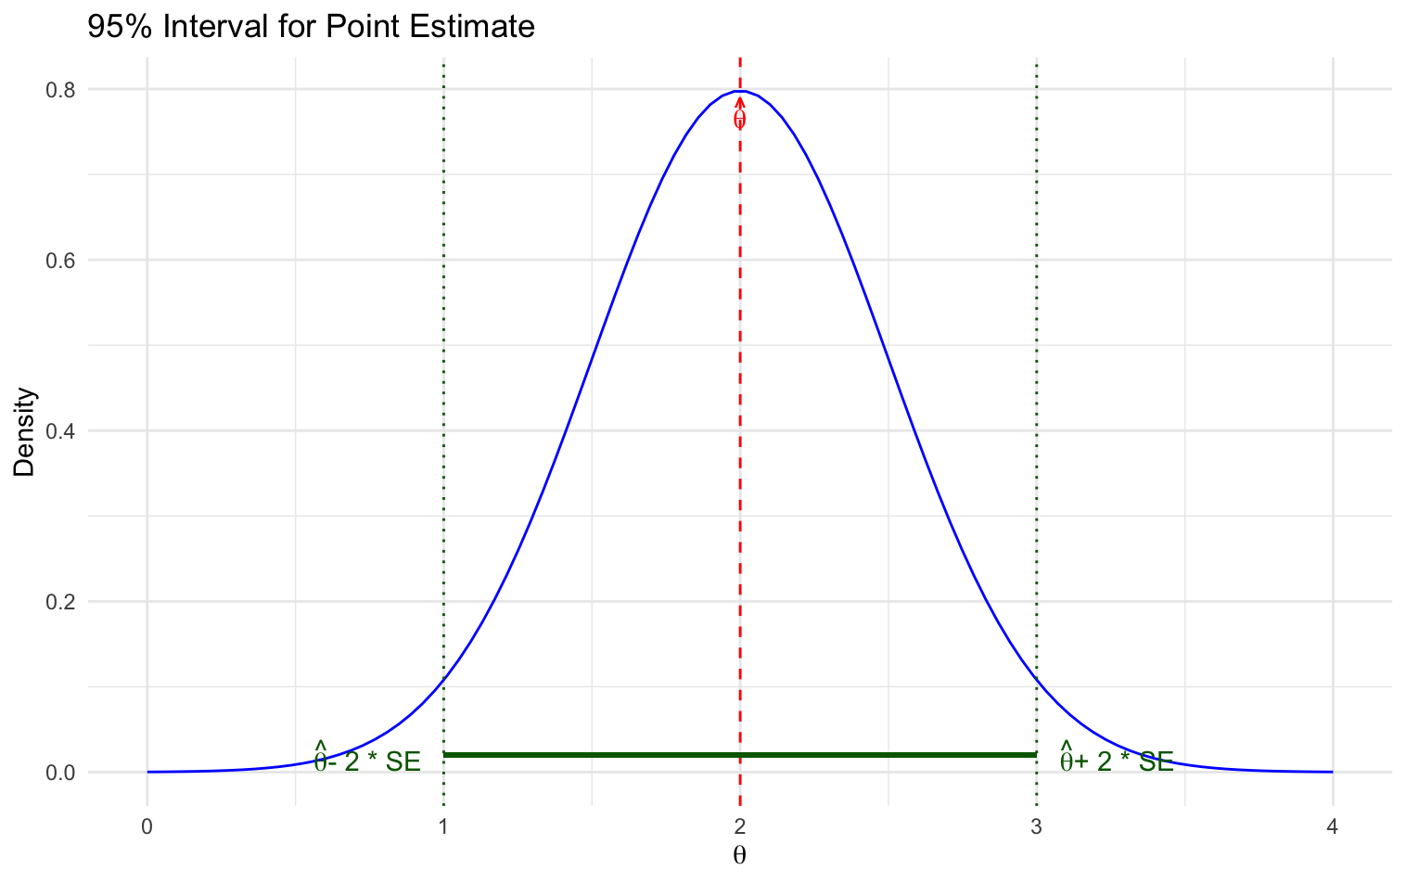
Advantages
Approximation of the distribution that is more accurate at the peak.
The rate of decrease from the mode is related to uncertainty.
This allows us to construct a 95% interval around the mode using the standard error.
The Bayesian mode correspond with the MLE!

Slide 13
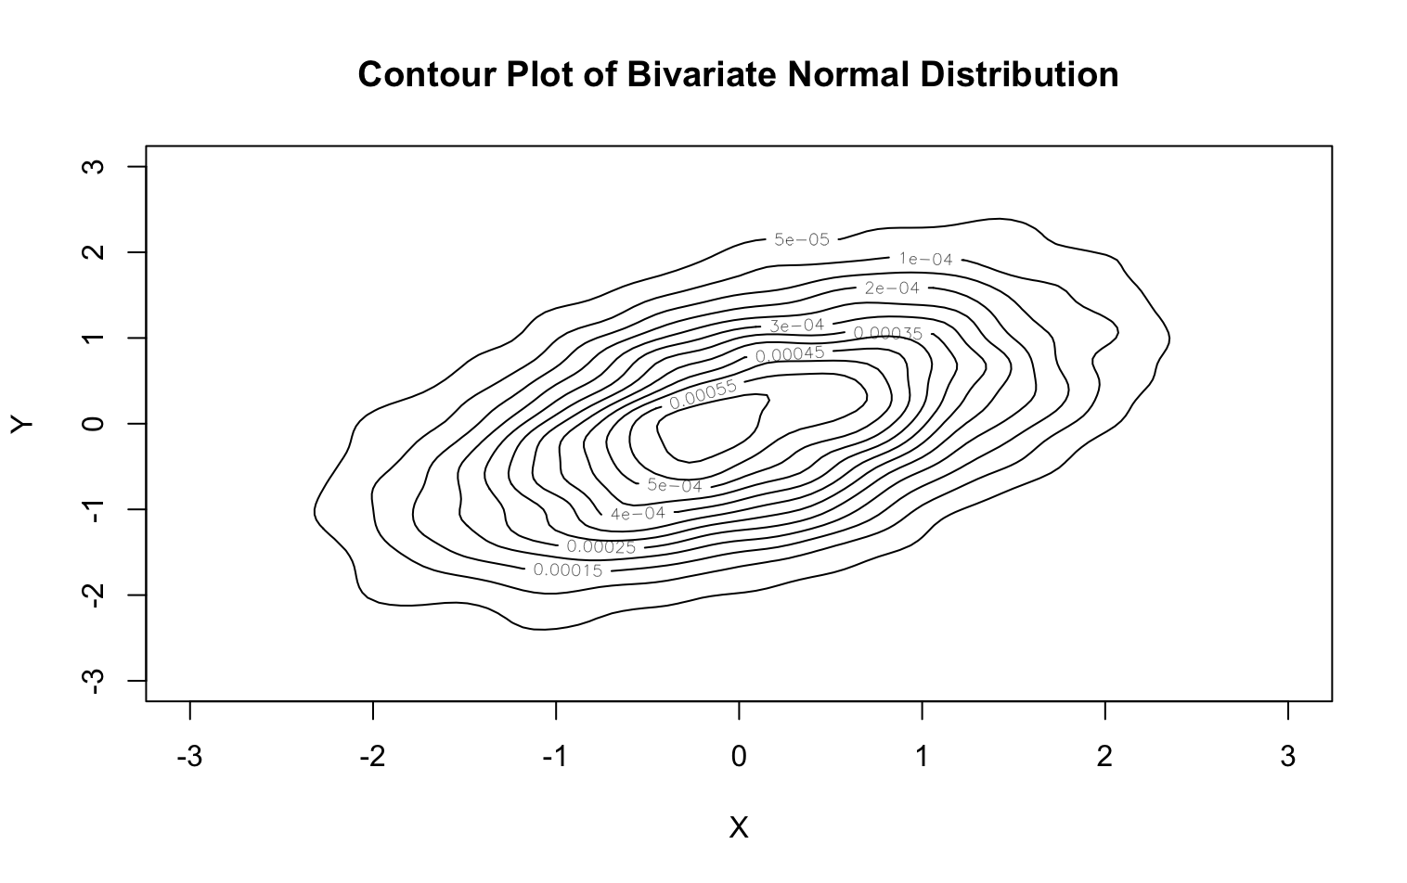
Contour Plots
Contour plots of this distribution can provide meaningful information.
Near the mode, these will be more accurate.

Slide 14
Next Time
Exploring Large-Sample Theory and Counterexamples

